Slide 1
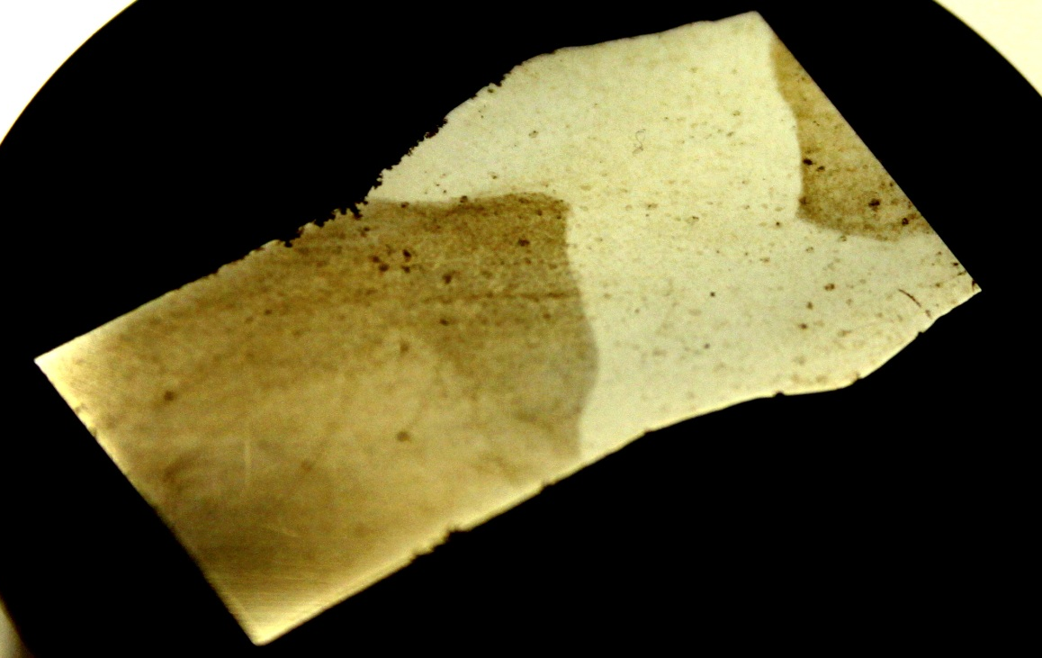
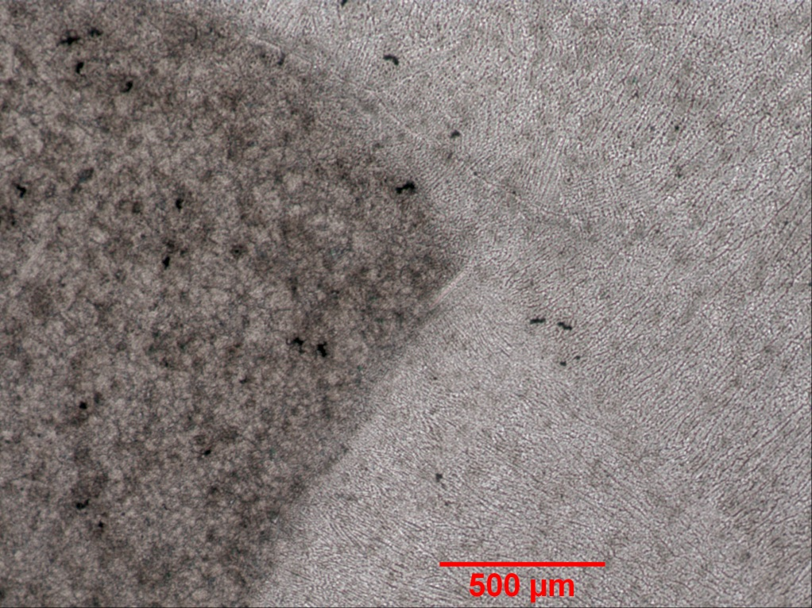
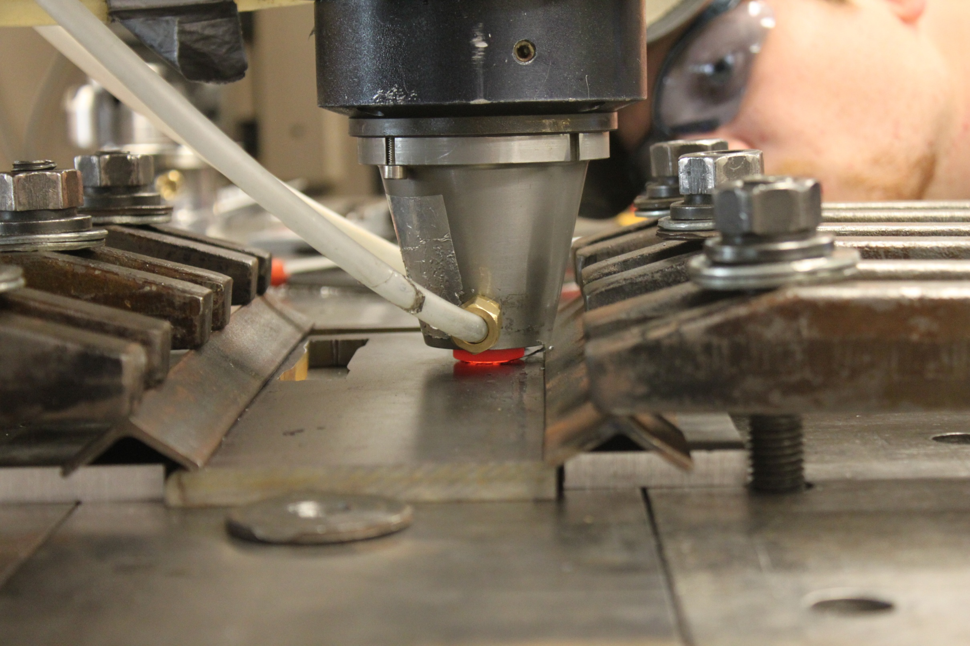
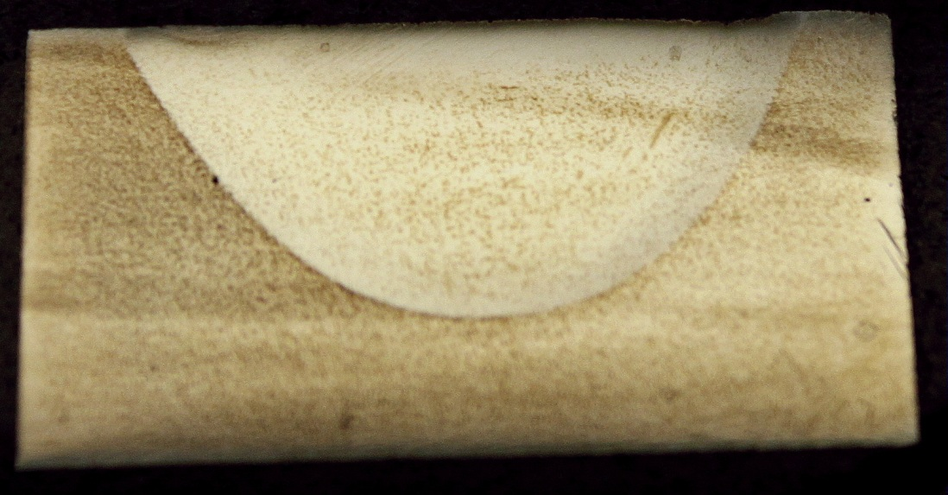
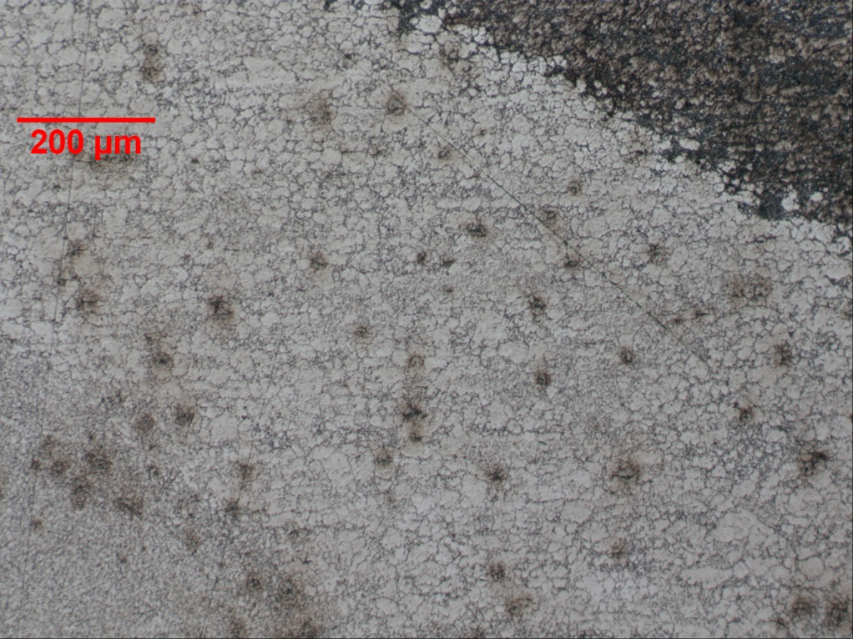
Friction Stir Welding of a Fine Grain Low-Alloy NUCOR Steel
Research Undergraduate: Madison Kincaid
Advisors: Dr. Michael West and Dr. Bharat Jasthi
Research Objectives
Measure differences in hardness, tensile strength and grain size across weld.
Determine weld parameters that maximize properties.
Look at whether FSW is a good replacement for arc welding in this application.
Introduction
Friction stir welding (FSW) is a solid state welding process that warms up the parent material to the point of plasticizing and then spins the metals together. While popular for aluminum friction stir welding of steels is by far less common. For this particular steel the fine grains make it a desirable candidate for FSW. The goal of this project was to look at whether FSW was a viable replacement for arc welding in this application.
Results
All test runs created defect free welds
High hardness at the center of the weld
The nugget had much smaller grains than the parent material.
Parent Material
Nugget
Procedure
NUCOR base metal characterized
NUCOR steel is friction stir welded and characterized
NUCOR arc weld characterized
Characterization
Grinding and polishing – Up to 1200 grit, followed by 1 µm and 0.3 µm polycrystalline solution
Electrolytic Etch –2% nitol
Micrographs taken with Nikon Epiphot 200 optical microscope
Vicker’s Hardness Testing, 300 g load, 20 seconds
HAZ
Figure 3: Arc welded sample
Figure 4: Arc weld micrograph
Figure 7: High magnification micrographs of welded and parent materials in a Friction Stir Weld
Figure 2: FSW bead on plate weld
Conclusions
FSW produces a stronger weld with better grain retention but with the parameters tested the sample ended up with a nugget that was too brittle
The FSW weld was harder than the arc weld and the nugget had grains more consistent with the parent material
Figure 5: FSW sample
Future Work
Heat treatment
Tensile comparisons
Treatment during weld to prevent excessive hardening.
Working with a thinner variation of the material
Tool wear especially over the long distances desired in this project
Figure 1: Bead on plate weld of parent material
Figure 6: FSW micrograph
Acknowledgements
Thanks to the National Science Foundation grant #1157074, Dr. Michael West, Dr. Bharat Jasthi, and Dr. Alfred Boysen

